Slide 1
Sustainable Development Goals（SDGs）
Online Program

Slide 2
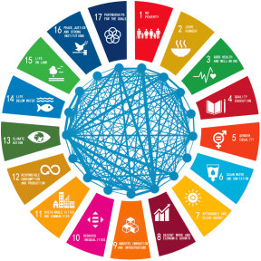
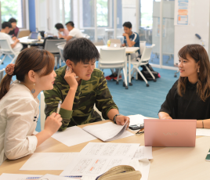
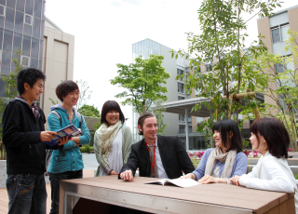
The goal is for participants to get equipped with knowledge on and analytical skills for food security in low-carbon societies. Participants will have an opportunity to explore how the SDGs (Sustainable Development Goals), set up by the United Nations General Assembly in 2015, are important for food security in societies actively trying to reduce CO2 emissions.
These lectures by Ritsumeikan University instructors and practitioners will be supplemented with online field visits, talks from people in the field, group research and discussions with Ritsumeikan students to further grasp the present situation and consider the future direction of these means to achieving the SDGs.
Outside of courses, there will be opportunity to meet, build friendships and strengthen international ties with regular students from the university. Participants will take part in activities together with these Ritsumeikan students and even receive a live-stream guided tour around a sightseeing spot in the Osaka area.

Slide 3
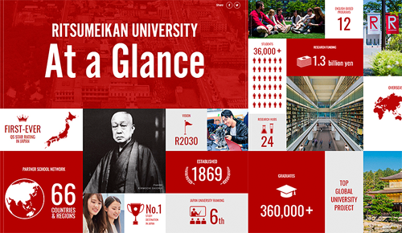
The Ritsumeikan Academy is one of the private comprehensive educational institutions in Japan with rich history and tradition, and we celebrated the 150th anniversary of the founding of the Ritsumeikan private school and the 120th year of the establishment of the Academy in 2020.
The school spirit of liberalism and internationalism advocated by Prince Saionji was combined with the ideals of academic freedom and innovation pursued by Nakagawa, and became a tradition of the Academy.
Today, the Ritsumeikan Academy is highly admired by society as the educational institution which actively promotes the university reform. Such spirit of innovation and inspiration is simply based on the Academy’s school spirit, “freedom and innovation.”

Slide 4
Ritsumeikan, as an institute of education and research, pledges to promote peace,
The above ideal, expressed in the Ritsumeikan Charter,
will guide us as we continue pursuing our own distinctive approach to achieving the SDGs.
We will seek solutions to the problems faced by Japan and the world by linking diverse
individuals and organizations, aiming to nurture talented individuals who can take on the
task of generating new knowledge.
Thus we will contribute to improving the societies of the future, in 2030 and thereafter.

Slide 5
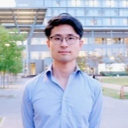
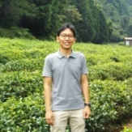
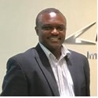
Schedule
09：45
11：15
13：30
15：00
8月23日
星期一
Orientation
Buddy Exchange Activity
8月24日
星期二
Introduction to SDGs
Field Tour
with Buddies
Theme:
Towards Sustainable Urban Societies:
Exploring the Potentials of Urban Agriculture
8月25日
星期三
Theme 1
Theme 1
Theme:
Integrating SDGs in Scenario Planning for Global Expansion:
The Case of Machi Koba (Micro-enterprise)
8月26日
星期四
Theme 2
Theme 2
8月27日
星期五
Group Discussion and Presentation Preparation
Group Discussion and Presentation Preparation
8月30日
星期一
Group Presentation
Completion Ceremony
Graduate School Info Session

Slide 6
Course Description
Course1: Introduction to SDGs
Outline:
The SDGs (Sustainable Development Goals) was set up by the United Nations General Assembly in 2015 to be achieved by 2030. Active stakeholders to achieve the SDGs include not only governments but also the private sector and citizens in general. While the goals cover a variety of aspects of our societies, this lecture pays special attention to food security and CO₂ reduction, both of which are urgent issues all over the world. The lecture introduces the background and structure of the SDGs and how it contributes to these issues by involving a variety of stakeholders.
Student Attainment Objectives:
1. To understand the details of the SDGs for food security and CO₂ reduction.
2. To grasp what the major stakeholders should do for achieving the SDGs.

Slide 7
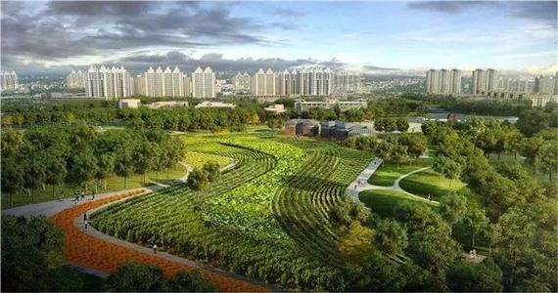
Course Description
Course2: Towards Sustainable Urban Societies:
Exploring the Potentials of Urban Agriculture
Outline:
Through this program, participants will be able to further understand the significance and potential benefits of urban agriculture to improve the socio-economic conditions as well as the wellbeing of urban dwellers. Urban agriculture also contributes in promoting sustainable cities and communities (SDG 11) with better food securities in urban settlements, ensuring sustainable consumption and production patterns (SDG 12) through increased production of local foods, and contributing to climate action (SDG 13) by reducing CO2 emission from agriculture production. In this program, impacts and challenges in urban agriculture practices in the urban community will be discussed through case study of urban farming in Ibaraki City, Osaka.
Student Attainment Objectives:
1.Participants will be able to understand the key factors in urban agriculture.
2.Participants will be able to identify potential issues and challenges in urban agriculture.
3. Participants will be able to formulate basic policy recommendations to promote urban agriculture.

Slide 8
Course Description
Course3: Integrating SDGs in Scenario Planning for global expansion
The case of Machi Koba (Micro-enterprise)
Outline:
This course will help students understand the concepts of scenario planning as a tool to identify key external drivers so that small and micro-enterprises can design and develop plausible scenarios for global expansion. At the same time, they can develop policies and strategies that can be used by the agencies to enable the expansion of the enterprise within the SDG framework.
The course will employ 2 cases:
1)BugMo Co., a startup based in the western Japan city, Kyoto, which produces items containing edible bugs, rich in umami ingredients, such as glutamic acid and inosinic acid. They aim to provide safe, nutritious and sufficient food all year round which is in line with the SDG goal of ending all forms of malnutrition (SDG 2 and 3).
2)Vantech Co is a small to medium-sized company that deals with mechanical water purification technologies. It develops cost effective innovations that are in correspondence to the Sustainable Development Goal 6 which is about “clean water and sanitation for all.”
Student Attainment Objectives:
1.To understand the importance of micro-enterprise in a global world.
2.To identify variables that can help account for future scenarios so as to proactively build adaptive solutions.
3. To be able to draw up strategic policy recommendations to promote global expansion within the SDG framework for a sustainable society.

Slide 9
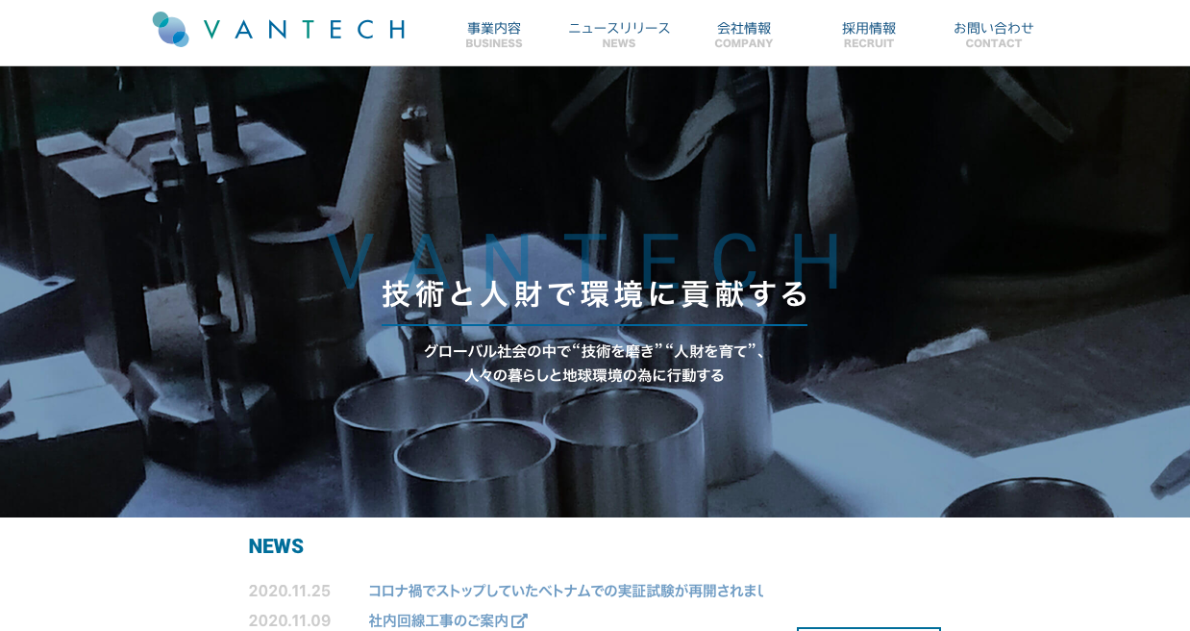
Case Study and Site Visit Companies
BugMo Co.
https://bugmo.jp/why-cricket/
有限会社VANTECH
http://vantech.biz/

Slide 10
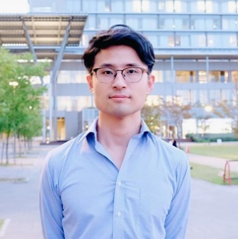
Course Instructors
Course Title: Introduction to SDGs
Keywords:
Policy Science, Disaster Prevention, Disaster Risk Reduction, Disaster Recovery, Community-based Approach, Gaming Simulation, Social Capital, Economic Assessment, Planning, Compact City, Historic City
Degrees:
Ritsumeikan University, B.A. in Policy Science
Ritsumeikan University, M.A. in Policy Science
Ritsumeikan University, Ph.D. in Policy Science
Specialized Fields: Social systems engineering/ Safety system, Natural disaster / Disaster prevention science, Area studies, Sociology, Social psychology, Experimental psychology
Dr. Yusuke Toyoda
Associate Professor
Deputy Director of Office of International Affairs
Director of OIC International Office
Course Title: Introduction to SDGs

Slide 11
Course Instructors
Course Title:
Towards Sustainable Urban Societies:
Exploring the Potentials of Urban Agriculture
Keywords:
Climate Change Adaptation, Sustainable Agriculture, Peri-urban Agriculture, Urban Agriculture, Terroir, Agroecology, Traditional Agriculture Knowledge
Degrees:
Trisakti University, Bachelor of Engineering
Ritsumeikan Asia Pacific University, Master of Science
Ritsumeikan University, Ph.D. in Policy Science
Specialized Fields: Agricultural and food economics-related, Rural sociology and agricultural structure-related, Agricultural environmental engineering and agricultural information engineering-related, Environmental agriculture-related, Social-ecological systems-related, Environmental policy and social systems-related
Dr. Fitrio Ashardiono,
Assistant Professor

Slide 12
Course Instructors
Course Title:
Integrating SDGs in Scenario Planning for Global Expansion:
The Case of Machi Koba (Micro-enterprise)
Keywords:
Innovation Systems, Information Communication Technology, Technology Transfer, University Centered Innovation System
Degrees:
Andrews University, B.A. in Information Systems
Ritsumeikan University, Msc in Information Systems
Ritsumeikan University, Ph.D. in Management of Technology
Specialized Fields: Environmental policy and social systems, Educational technology, Management, Education, Innovation Systems and management, Renewable Energy Technology
Dr. Otieno Francis Xavier,
Associate Professor

Slide 13
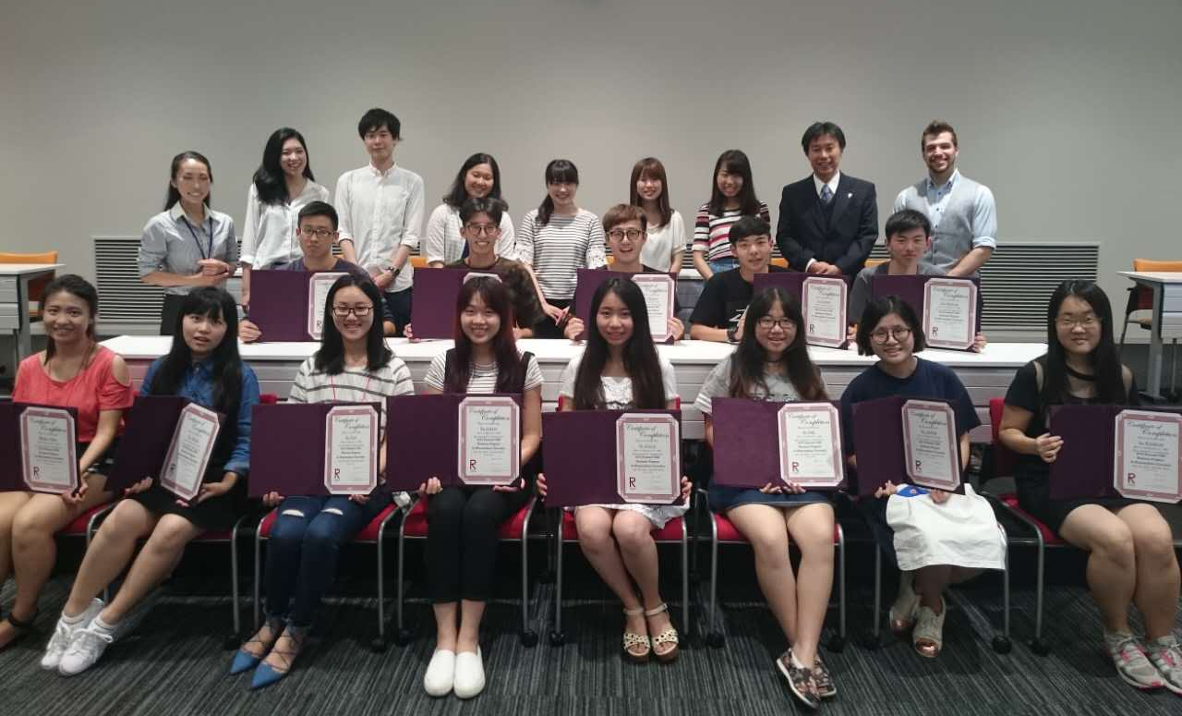
Program application
Participants | Undergraduate / graduate students
Language of contest | English
Expenses | 4980 RMB
Application link | apply.xf-world.org
Application deadline | August 15, 2021
contact Us | 021-55661085 Duanqi@xf-world.org Room 204, block B, AVIC Tiansheng building, Yangpu District, Shanghai
¥
Upon conclusion of the program
participants will be presented with a certificate of
completion from Ritsumeikan University.

